Slide 1
DSI Capstone Project ideas
DSI13 - Isabelle Tontchev

Slide 2
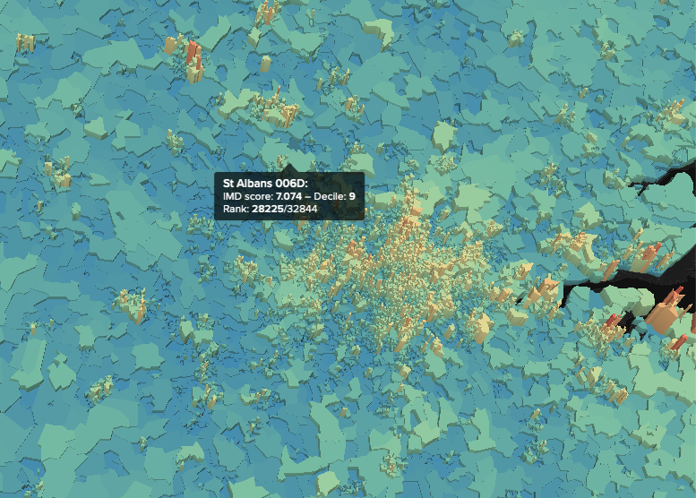
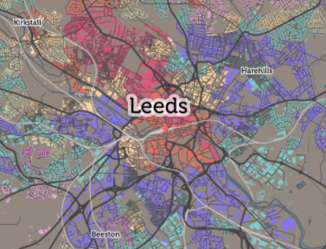
The internet wealth gap
Problem statement: Is internet access associated with income?
Potential audience: NGOs, government, charities, big internet providers.
Goals: Try to establish whether there is a link between frequent internet use and information about household income. Predict internet use by area, given income.
Success metrics: prove or disprove the hypothesis at high statistical significance. Predict based on income, educational level what the internet access that is availables
Data Sources: CDRC internet use and engagement, Index of multiple deprivation, OFCOM, Census data

Slide 3
Youtube & discogs - nlp.. sentiment analysis
Problem statement: Can I predict the genre of music from the youtube comments?
Potential audience: Marketing companies, Brands.
Goals: Use NLP to understand the strength of sentiment of comments in various Youtube videos. Discogs has the classification of the styles and genre.
Success metrics: NLP, classification, clustering. Is there a clear trend between the language used genre.
Data Sources: Youtube API, Discogs API. Discogs data per year. Teststat - python package to calculate statistics from text to determine readability, complexity and grade level of a particular corpus.
Primary key: Discogs & Youtube

Slide 4
Yelp Business Reviews - NLP & Sentiment Analysis
Problem Statement: Can I predict the Sentiment of a review, more specifically, could it be funny, useful or cool
Use textstat to calculate statistics from text to determine readability, complexity and grade level of a particular corpus.
Use NLP and sentiment analysis.

